Slide 1
Physical query plans

Slide 2
Overview of this video
SQL query
Parse query & preprocess
Logical query plan (relational algebra)
Optimise logical query plan
Optimised logical query plan
Select physical query plan
This video
Physical query plan
Query Execution

Slide 3
What is the purpose of a physical query plan?
A physical query plan adds information required to execute the optimised query plan
Which algorithm to use for execution of operators?
Naïve selection or selection with an index?
Nested Block Join or Sort Join or Hash Join etc.?
How to pass information from one operator to the other?
Write to disk, keep in memory, pipelining operators, etc.?
Good order for computing joins, unions, etc.?
Additional operations such as sorting

Slide 4
From Logical Plans To Physical Plans
Optimised logical query plan
Generate many different physical query plans
Estimate cost of execution for each plan
Time
Disk accesses
Memory
Communication
…
Select physical plan with lowest cost estimate
Physical query plan 3
Physical query plan 1
…
Physical query plan n
Physical query plan 2
Cheapest plan
execute

Slide 5
Estimating the Cost of Execution
Here: number of disk access operations
Number of disk accesses influenced by many factors:
Selection of algorithms for the individual operators
Method for passing information
Size of intermediate results
Estimated from parameters of the database
Important paramters:
Size of relations
Number of distinct items per attribute per relation
Computed exactly from the database or are estimated (“statistics gathering”)
One of the most critical factors

Slide 6





Estimating Intermediate Result Sizes
One of the most challenging tasks of a DBMS
Difficult even for nodes close to the leaves
Cannot afford executing the query
Rely on statistics gathered from data
Many different approaches
Some easier than others
With join size estimation, we enter active research…
$π$_{worksAt,name}
$⋈$_{depart=worksAt}
Size?
$π$_{depart}
$π$_{worksAt,name}
$σ$_{city=Liv}
Employees
Stores

Slide 7
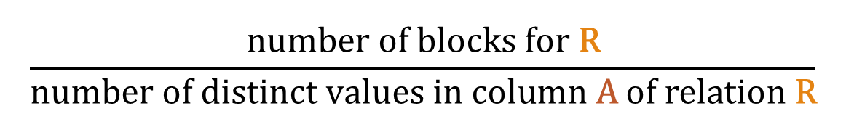
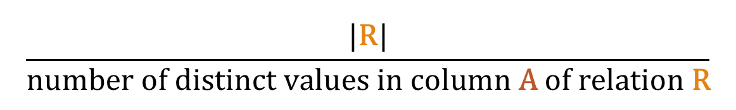

Estimating the Size of a Selection
Estimate for the size of $σ$_{A=a}(R):
Estimate for the # of blocks required to store $σ$_{A=a}(R):
Good if values in column A of R occur equally often, but can be bad
Recall: |R| = number of tuples in R
$$\frac{|\text{R}|}{\text{number} \text{of} \text{distinct} \text{values} \text{in} \text{column} \text{A} \text{of} \text{relation} \text{R}}$$
$$\frac{\text{number} \text{of} \text{blocks} \text{for} \text{R}}{\text{number} \text{of} \text{distinct} \text{values} \text{in} \text{column} \text{A} \text{of} \text{relation} \text{R}}$$

Slide 8



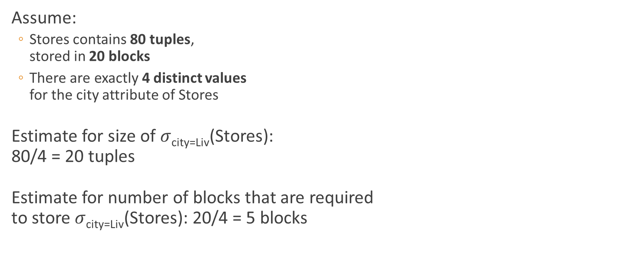


Example
Assume:
Stores contains 80 tuples, stored in 20 blocks
There are exactly 4 distinct values for the city attribute of Stores
Estimate for size of $σ$_{city=Liv}(Stores): 80/4 = 20 tuples
Estimate for number of blocks that are required to store $σ$_{city=Liv}(Stores): 20/4 = 5 blocks
$π$_{worksAt,name}
$⋈$_{depart=worksAt}
$π$_{depart}
$π$_{worksAt,name}
$σ$_{city=Liv}
Employees
Stores
Size?

Slide 9
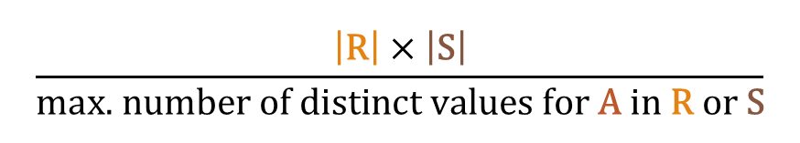
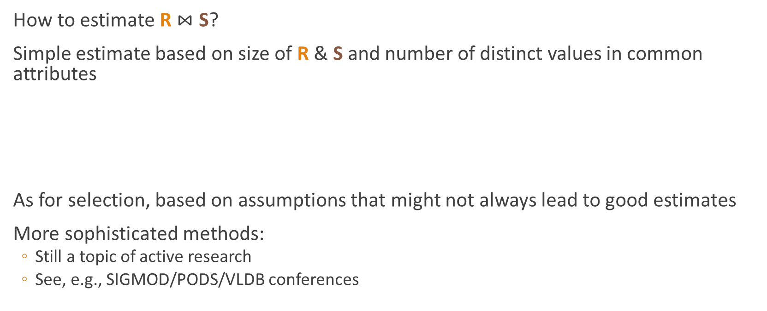
Joins
Assume A is the only common attribute.
How to estimate R $⋈$ S?
Simple estimate based on size of R & S and number of distinct values in common attributes
As for selection, based on assumptions that might not always lead to good estimates
More sophisticated methods:
Still a topic of active research
See, e.g., SIGMOD/PODS/VLDB conferences
$$\frac{\left|\text{R}\right|×\left|\text{S}\right|}{\text{max}\text{. }\text{number} \text{of} \text{distinct} \text{values} \text{for} \text{A} \text{in} \text{R} \text{or} \text{S}}$$

Slide 10
Other Issues
How to generate physical query plans?
Explore all?
More sensible approaches: top-down/bottom-up
Selection of a suitable algorithm for each operator
based on size of intermediate result
Selection of a good join order
also based on size of intermediate results

Slide 11

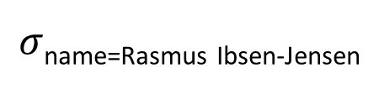

Example where join order matters
SELECT * FROM Lecturers NATURAL JOIN Modules NATURAL JOIN Students WHERE Lecturers.name = Rasmus Ibsen-Jensen
$$⋈$$
$$⋈$$
$σ$_{name=Rasmus Ibsen-Jensen}
Students
Modules
Lecturers

Slide 12


Example where join order matters
SELECT * FROM Lecturers NATURAL JOIN Modules NATURAL JOIN Students WHERE Lecturers.name = Rasmus Ibsen-Jensen
$$⋈$$
$$⋈$$
$σ$_{name=Rasmus Ibsen-Jensen}
Students
Modules
Lecturers

Slide 13
Other Issues
How to generate physical query plans?
Explore all?
More sensible approaches: top-down/bottom-up
Selection of a suitable algorithm for each operator
based on size of intermediate result
Selection of a good join order
also based on size of intermediate results
How to pass information from one operator to another?

Slide 14


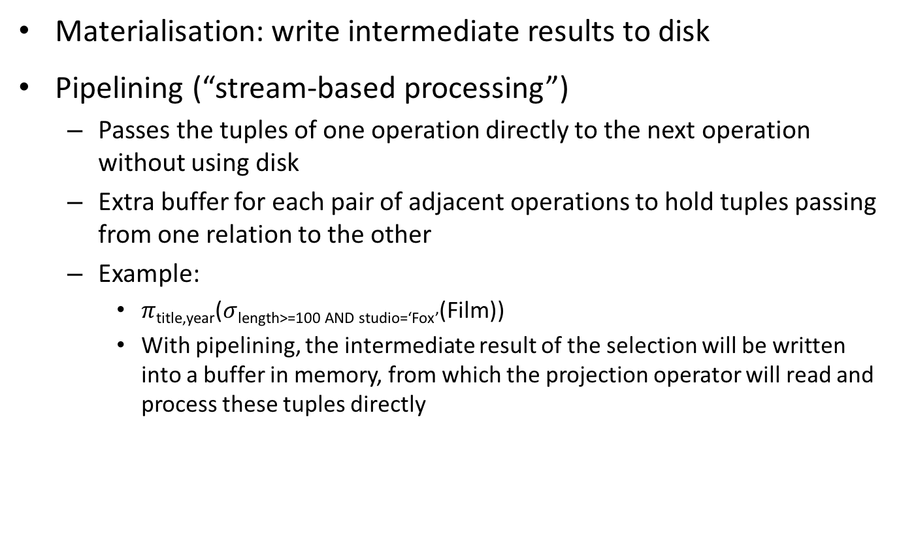
Passing Information
Materialisation: write intermediate results to disk
Pipelining (“stream-based processing”)
Passes the tuples of one operation directly to the next operation without using disk
Extra buffer for each pair of adjacent operations to hold tuples passing from one relation to the other
Example:
$π$_{title,year}($σ$_{length>=100 AND studio=‘Fox’}(Film))
With pipelining, the intermediate result of the selection will be written into a buffer in memory, from which the projection operator will read and process these tuples directly
Film
Buffer
$σ$_{length>=100 AND studio=‘Fox’}
Buffer
$π$_{title,year}

Slide 15
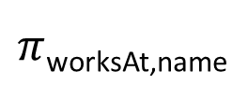
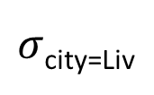
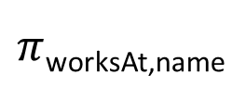

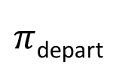
From Logical to Physical Query Plan
$π$_{worksAt,name}
Projection
Assumption:
Stores has index on city
depart is a key of Stores
Pipeline
Sort join (left leaf outer)
$⋈$_{depart=worksAt}
Can’t always do this pipeline here – depends on the amount of overlap
Since depart is key of stores it is fine here (we can always do it on the left, due to it being the outer one here)
Pipeline
Pipeline
Projection
$π$_{depart}
$π$_{worksAt,name}
Pipeline
Projection
Pipeline
$σ$_{city=Liv}
Employees
sort on depart
sort on worksAt
Stores
Can’t do pipelines on sort, due to requiring multiple scans
Selection using index on city
Pipeline

Slide 16
Summary
In this part, we have seen how to go from a SQL query to how exactly we are going to solve it!
Specifically, in this video, we saw how to go from a optimised logical query plan to a physical ditto

